Slide 1
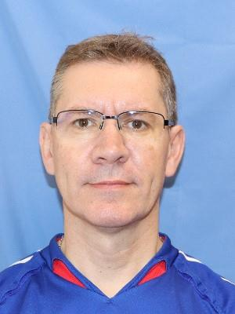
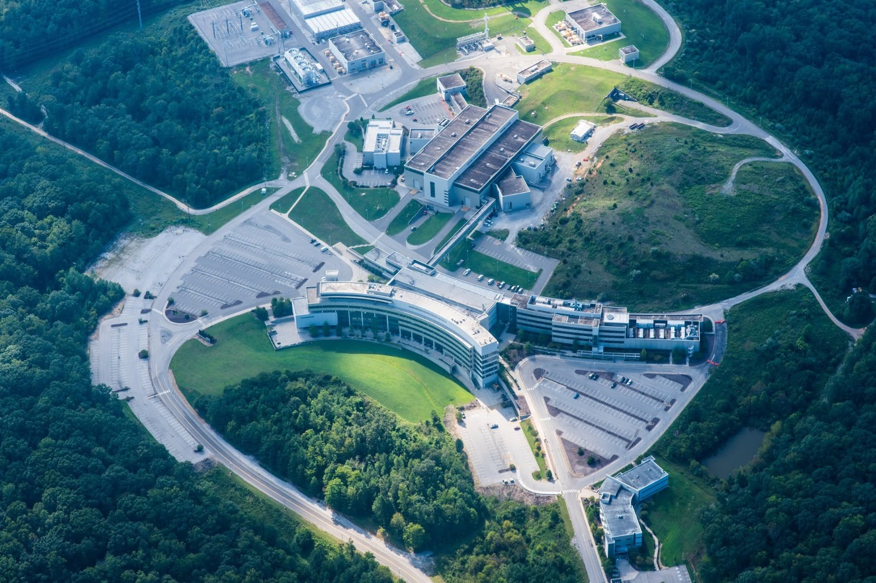
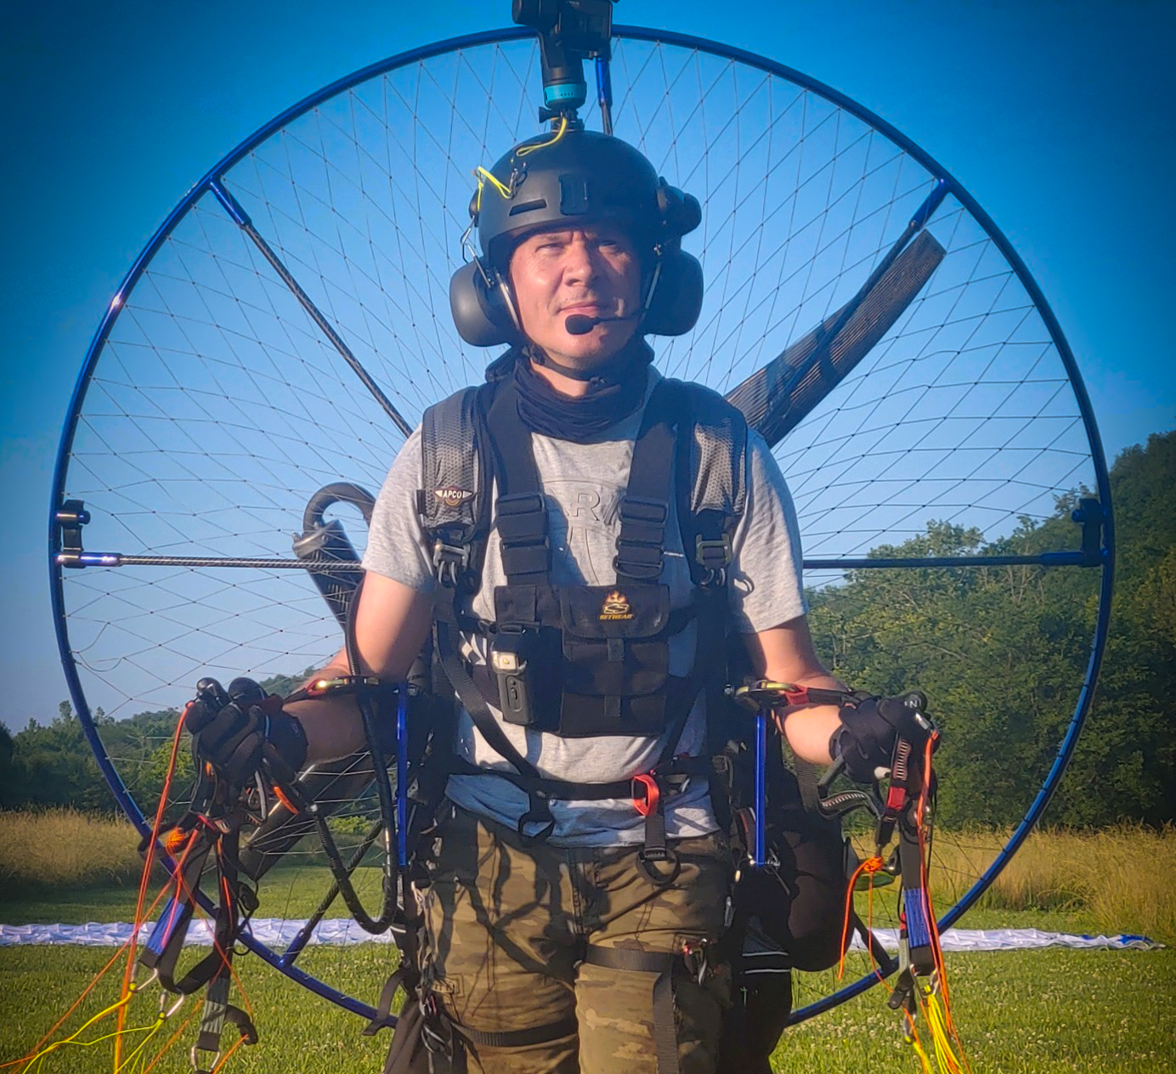

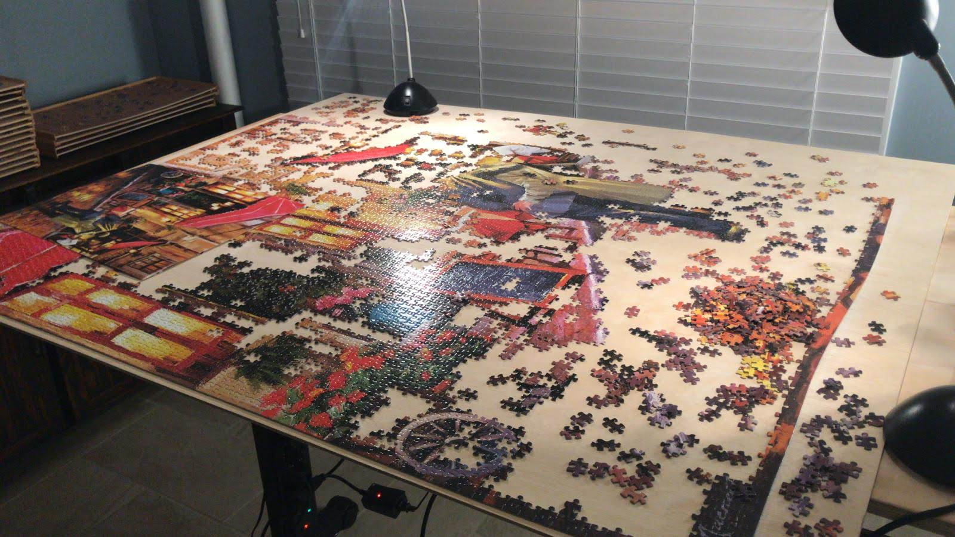

Jean Bilheux received his PhD in Physics in 2003 from the University of Versailles-Saint-Quentin (France) and did a couple of post-docs at the Oak Ridge National Laboratory (physics division and the Spallation Neutron Source, SNS). He became staff at the SNS in 2007.
Jean is the now the neutron imaging computer instrument scientist and in charge of providing easy to use tools for all kinds of users programming skills.
Jean has more than 10 years of python development and graphical user interface implementation expertise.
His interests are always providing the easiest to use suit of tools for the user, using technology such as PyQt or Jupyter notebooks.
Outside of work Jean has way too many hobbies such as flying (glider, single engine and paramotor), mountain biking, playing bass, playing tennis, photography, assembling large puzzles, and so many more.

